Slide 1
Analysis of E-Commerce Order Data
Submitted by :-
Digant Vaibhav Gupta
Mob: 9745032462

Slide 2
Roadmap
Introduction
Solution Design
Order Level Data
Cart Level Data
SKU Analysis with various factors
Revenue/Profit analysis
Cart Size Analysis
Linear Regression model in R

Slide 3
Introduction
The data given consists of total 7787 rows and 12 columns.
Columns:
Order Date (Date and Time)
Order Number (Order ID)
SKU Code (Product ID)
Product Gender
Quantity Ordered
Cost (Cost per Unit)
MRP (MRP per Unit)
State
Country
Order Total
Channel

Slide 4
Solution Design
Analysis of the data has been divided in two parts:-
1) Order Level data
It is the original form of data in which every order is treated as an individual source of information.
2) Cart Level Data
It is a modified form of original data where we have combined all orders belonging to a single customer having same Order Number

Slide 5
Order Level Data
New Variable Introduced: Profit Margin
Profit Margin = MRP-Cost
Higher average profit margin for a SKU can yield higher revenues and can be sold on higher discounts.
Mainly focusses on the individual SKU Codes and their analysis across various factors like Gender, State, Sales Channel and Profit Margin

Slide 6
Cart Level Data
Combining all orders for a customer having same Order ID
Variables Modified : Cost , MRP
Total Cost = Sum(Cost * Quantity) (Total cost of a cart)
Listed Price = Sum(MRP * Quantity) (Total MRP of a cart)
New Variable Introduced: Cart Size, Discount and Profit
Cart Size = Sum(Quantity Ordered)
Discount = Listed Price – Revenue(Order Total)
Profit = Revenue – Total Cost
Mainly focusses on Revenue and Profit and their analysis across various factors like Date of the Month, Hour of the Day, State ,Sales Channel and Cart Size

Slide 9
Recommendations for SKU by Gender
We can determine the popular SKU among men and women to decide on our promotional strategies.
By determining the popular trends we can target the masses using celebrity endorsements.
Popular products can be showcased in advertisements on online as well as offline channels of promotion.
We can segment our customers on demographic variables and recommend the products to them on our website.

Slide 11
Recommendations for Discount on particular SKU
We can offer huge discounts on the SKU which are having high profit margins.
Cutting down the profit margin and offering discounts can actually drive higher sales.
The additional volume of sales derived from this strategy can results into:
Higher revenue
Cover the opportunity cost of offering high discounts
Customer delight and loyalty

Slide 16
Recommendations for popular SKU by top 3 States
Different states may have different choice of jewelry depending on the lifestyle, culture and local trends.
We can determine the popular SKU for individual states and plan our promotions accordingly.
Popular SKU must be stocked in sufficient quantities so that we don’t face stock-out problems.
Product bundling strategy can be used to bundle the lesser popular SKU with the more popular ones where the customer can buy the products for a lesser amount as compared to sum of individual products.

Slide 21
Recommendation on SKU sold by different channels
We can determine the customer behavior by analyzing the differences in top selling SKU by channel of sales.
Channels must be equipped with sufficient inventory to avoid stock-out problems.
Separate promotional strategy for every channel targeted on individual segment of customers can be formulated.
Strategies for Channel efficiency, cost reduction and resource optimization can be built.

Slide 22
Revenue/Profit/Avg. Discount by DATE

Slide 23
Interpretation and Recommendations
We can see from the graph that offering huge discounts drive the higher sales.
As opposed to the popular intuition that offering huge discount will reduce the profitability, the graph shows that by offering huge discount (from 40% to 60% ) on 7 May the revenue and profit both go up by 100%
This is primarily due to the higher sales achieved by offering great discounts.

Slide 24
Revenue/Profit/#Orders by HOUR of the Day

Slide 25
Interpretation and Recommendations
We can interpret from the graph that maximum orders are placed during the time intervals 12PM to 2 PM and 3PM to 5PM.
Third peak is achieved during the time interval 5PM to 7 PM.
We must ensure the channels of sales are properly functional at these times.
Increase in traffic on websites must not reduce the efficiency and speed.

Slide 26
Avg. Discount/#Orders by Sales Channels

Slide 27
Interpretation and Recommendations
Channel5 is driving the maximum sales in terms of orders placed followed by Channel 1 and Channel 10.
If we look at the average discount being offered across various channels 11,12 and 6 are offering average discount equivalent to the top performing channels but they are driving very low sales.
Further analysis is required to determine the reasons and how we can improve these channels and drive higher sales.

Slide 29
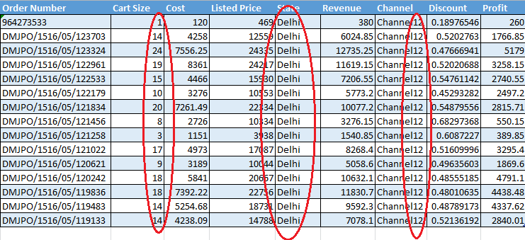
Very High Cart Size for Channel 12 in Delhi

Slide 30
Interpretation and Recommendations
We can see that the orders placed through Channel12 in Delhi are having exceptionally high cart size as compared to other channels and states.
Further analysis is required to determine the reasons behind this observation.
We can follow the same strategy used in this combination of channel and state to drive higher cart size for orders placed in other channels and states.

Slide 31
Avg. Profit /Avg. Discount V/S Cart Size

Slide 32
Interpretation and Recommendations
Data doesn’t exist for cart size 12, 13, 21 and 23.
Average profit increases exponentially as the cart size of the orders increase.
It is evident from the graph that for orders of higher cart size increase in average discounts can decrease the profitability to an extent.
Similarly decrease in average discounts at higher cart size can shoot up the profits to a great extent.

Slide 33
Linear Regression to determine the revenue and the factors behind it
In order to run a linear regression we have used the cart level data.
Observations with negative and zero revenue has been removed from the dataset.
Observations with negative profitability have been removed from the dataset.
Observations having null values in states have been removed from the dataset.
Observation having Country other than Indian have been removed from the dataset as they are very few in number and insufficient to influence the model

Slide 34
Building the linear regression model
Using Revenue (Order Total) as the dependent variable.
Using Hours, Cart Size, Total Cost, Listed Price, State, Channel, Discount and Profit as the independent variables.
Removing multicollinearity of the variables by removing variables one by one which have VIF >2.5 (Variance Inflation Factor)
Dividing the dataset into Train_Data and Test _Data in the ratio 7:3 respectively.
Running the model on Train Data and evaluating the model on Test_data.

Slide 35
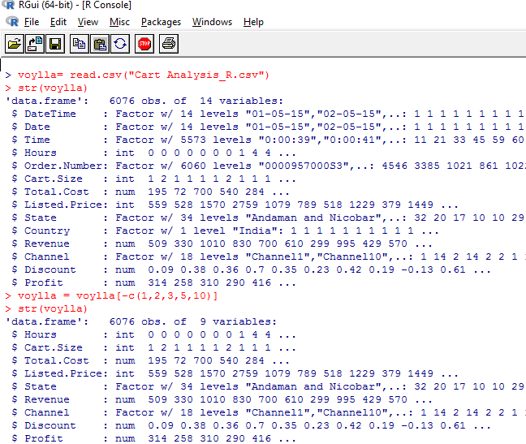

Slide 36
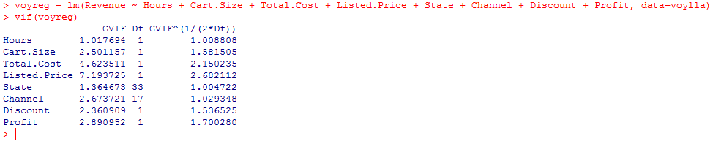
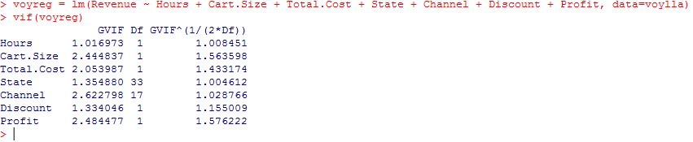
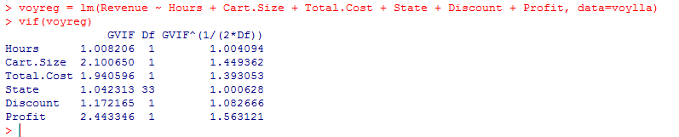
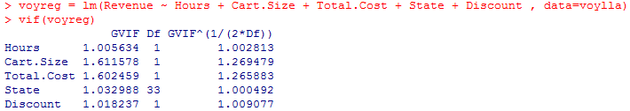

Slide 37
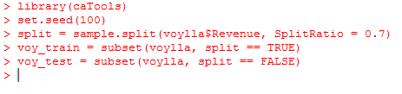
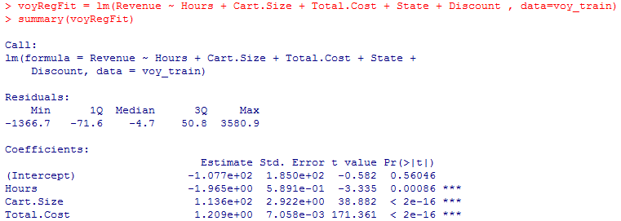
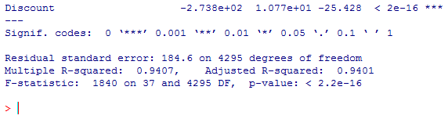

Slide 38
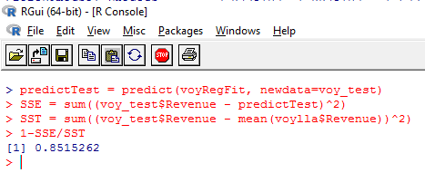
Regression Equation: -
Revenue = -107.7 + (-1.96)* hours + 113.6*Cart_Size + 1.21*Total_Cost + 691.2*(State_Dadar&NagarHaweli) + (-273.8)*Discount
Where baseline state = Andaman & Nicobar
Discount is measured with a baseline of 1 so we will divide the coefficient by 100 to measure the increase of 1 % in discount.

Slide 39
Interpretation of the Model
Keeping all other factors constant, a unit increase in hours (0-24) will lead to a reduction of 1.96 units in the revenue.
Keeping all other factors constant, a unit increase in Cart Size will lead to an increase of 113.6 units in the revenue.
Keeping all other factors constant, a unit increase in Total Cost will lead to an increase of 1.21 units in the revenue.
Keeping all other factors constant, if the state of the customer changes from Andaman & Nicobar to Dadar & Nagar Haweli then it leads to an increase of 691 units in the revenue.
Keeping all other factors constant, a unit increase in discount percent will lead to a decrease of 2.73 units in the revenue.

Slide 40
Thank You
and
Have a Nice Day!!!

